Slide 1

If I was stereotype Asian-American Parent, What data might interest me?
Supadit W.
MINK

Slide 2


Instagram vs. Real-life

Slide 3
Before digging data up
In the class of 2020, SAT test-takers: 2.2 million > ACT test-takers: 1.7 million
More and more students are taking both (last 5 to 10 years )
SAT costs 52 USD and ACT costs 55 USD (70 USD if the optional writing test is included)
Students may also be able to take the SAT or ACT for free thanks to state support or fee waivers.

Slide 4
Don’t think! Go test!
Although SAT and ACT is not required in most school in USA at the time (1,000++), many schools made it optional for students to send SAT/ACT score along with your GPA and Activities (Leadership program, Volunteer, etc.) report.
What if there are other students who got same GPA and same Activities?

Slide 5
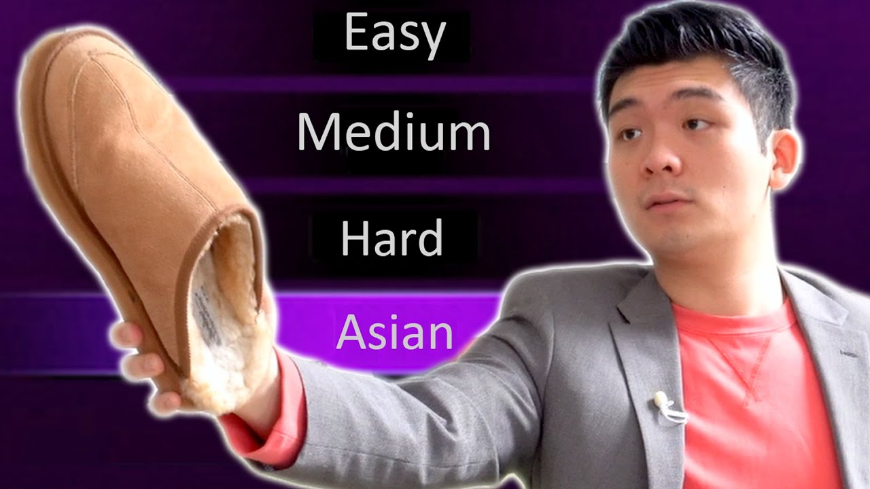

Slide 6
SAT OR ACT OR BOTH
ACT: 1-36
SAT 2019,2018,2017 | ACT 2019,2018,2017
Mean = 1106.53 - 1126.1 is equivalent to 21-22 in ACT. | Mean ≈ 21 is equivalent to 1060~1090 in SAT.
SAT mean ≈ ACT mean
Min = 935-977 is equivalent to 17-18 in ACT | Min ≈ 18 is equivalent to 960-980 in SAT.
SAT min ≈ ACT min exception : 2017 min value = 2.3 (Someone didn't read enough textbooks)
SAT max = 1284 - 1295 is equivalent to 27 in ACT. | ACT max ≈ 25 is equivalent to 1200-1220 in SAT.
SAT max > ACT max

Slide 7
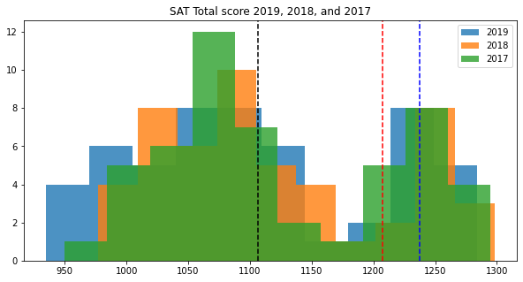
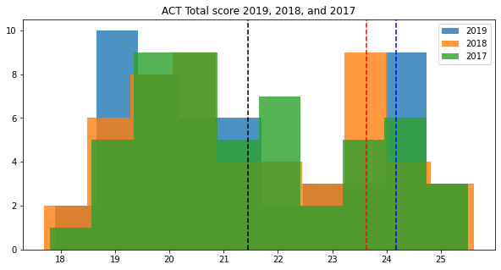
SAT and ACT score distribution shows we have two groups of population
Black line ; Mean
Red line: Mean+SD
Blue line: Mean+1.3SD
Black line ; Mean
Red line: Mean+SD
Blue line: Mean+1.25SD

Slide 9
Acceptable score for Asian-Parents
Average STDDev : 94.61
Average Mean : 1119.73
Average Max : 1292.33
Calculation | Score | Asian Parent’s Satisfaction | Real-life
Mean + 3SD | 1403.56 | Good | 8% from 1.5M (SAT 2021)
Mean + 2SD | 1308.95 | Acceptable | Reachable
Mean + SD | 1214.34 | Study harder | Great score
Mean + 1/2SD | 1167.04 | Disgrace to ancestors | Good Score
Mean | 1119.73 | I’m not your father | Mean Score

Slide 10
Acceptable major for Asian-Parents
College Major | Accept Rate
Clinical Sciences | 18%
Business, Management, Marketing | 12%
Engineering | 11%
Biological/Biomedical Sciences | 8%
and not Arts | 7%

Slide 11
Acceptable school for Asian-Parents
School | Accept Rate
Stanford University – California | 4.3%
Harvard College – Massachusetts | 4.7%
Princeton University – New Jersey | 5.5%
Columbia University – New York | 5.5%
Yale University - Connecticut | 6.1%
California Institute of Technology | 6.4%
MIT - Massachusetts | 6.7%

Slide 12
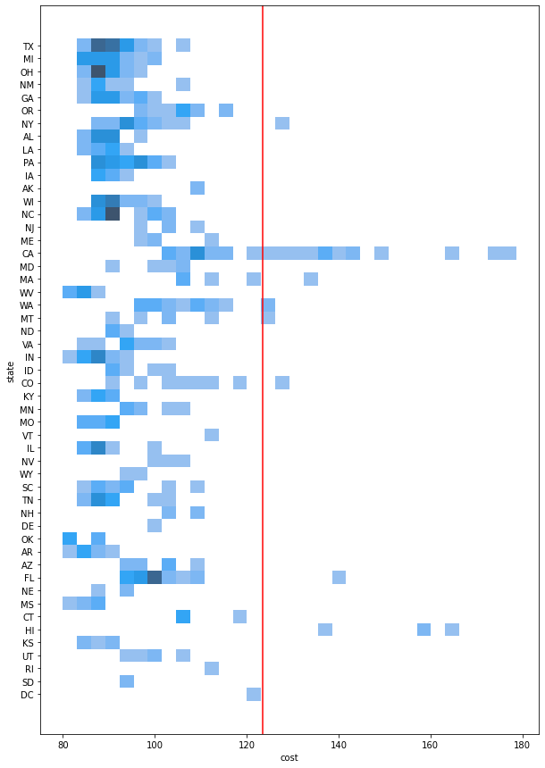
Cost of living index in USA (Normal=100)
Cost of living index | Value | Note to self
Mean | 97 | Ok!
Mean + SD | 109.98 | Aight!
Mean + 2SD | 123.43 | This is getting hard
Mean + 3SD | 136.87 | I ‘m struggling
Max | 178.6 | I’m dead
The cost of living of some cities in eight states goes beyond 2SD which are
New York , California, Massachusetts, Washington
Montana, Colorado, Florida, Hawaii.

Slide 13


Cost of living index (Normal=100)
State | School | Mean cost of living index
California | Standford University California Institure of Techonology | 125.75
Massachusetts | Harvard College MIT | 114.55
Connecticut | Yale University | 108.56
New Jersey | Princeton University | 103.4
New York | Columbia University | 97.04

Slide 14
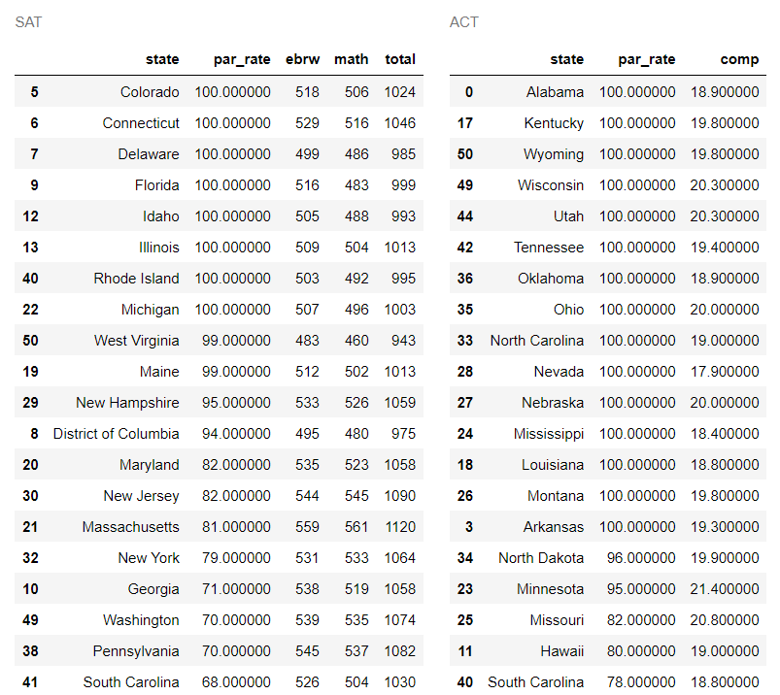
Be one step ahead
State with total ≥20 | Cost of living index ≤ 100
Wisconsin | ≤ 100
Ohio | < 100
Nebraska | < 100
Missouri | < 100
Low
Cost of living index
State Support

Slide 15
Conclusion

Slide 16
Thank you
For
Your Attention

